Slide 1
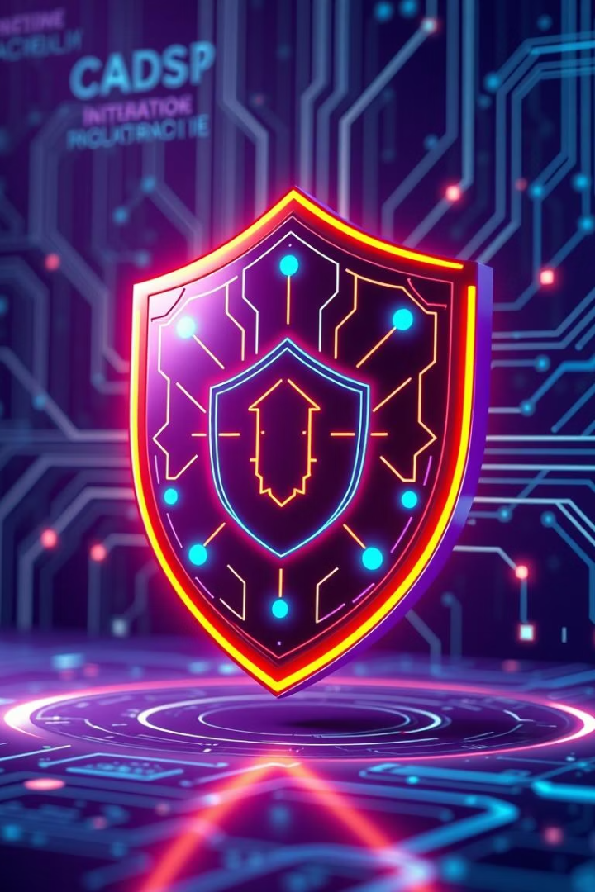
CYBER_EYE: AI-Powered Real-Time Phishing Detection System
Presented at Innothon by : Y Coder's 2.0

Slide 2
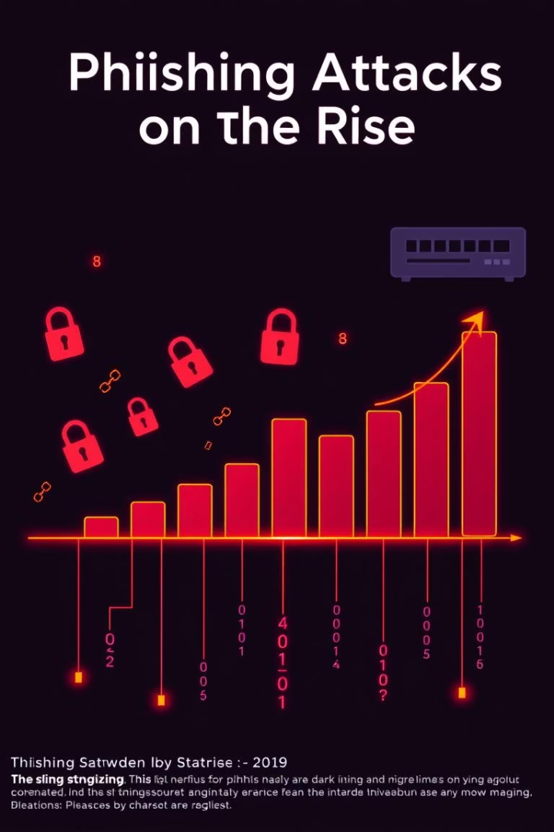
The Problem: Phishing is Surging
Attack Growth
Financial Loss
Phishing attacks climbed 61% in 2023 (Verizon DBIR).
$9.9 billion lost to phishing scams in 2023 (FBI report).
Breach Cost
Average breach costs $4.45 million impacting businesses drastically.

Slide 3
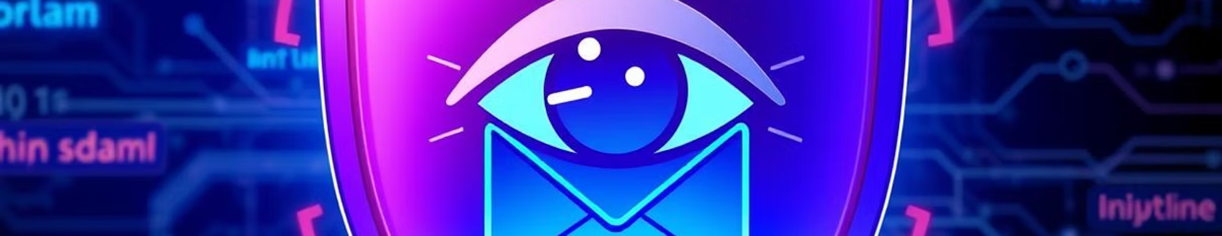
Introducing CYBER_EYE: The Solution
AI-Driven Detection
Proactive Mitigation
Advanced Techniques
Real-time identification of phishing threats using advanced AI.
Stops attacks before they reach users, minimizing risk.
Counteracts sophisticated phishing strategies effectively.

Slide 4
How CYBER_EYE Works: Core Components
Natural Language Processing
Machine Learning
URL & Domain Analysis
Threat Intelligence Feed
Recognizes patterns and adapts to new threats.
Analyzes content context for phishing indicators.
Real-time inspection of suspicious links and domains.
Integration with current databases of phishing sources.

Slide 5
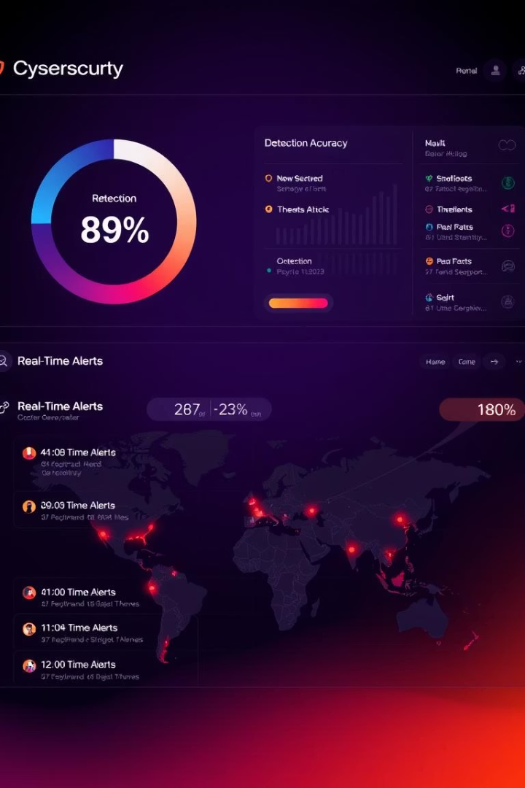




Key Features & Benefits
97.9% Accuracy
Under 1 Second Analysis
Adaptive Learning
User-Friendly Dashboard

Slide 6
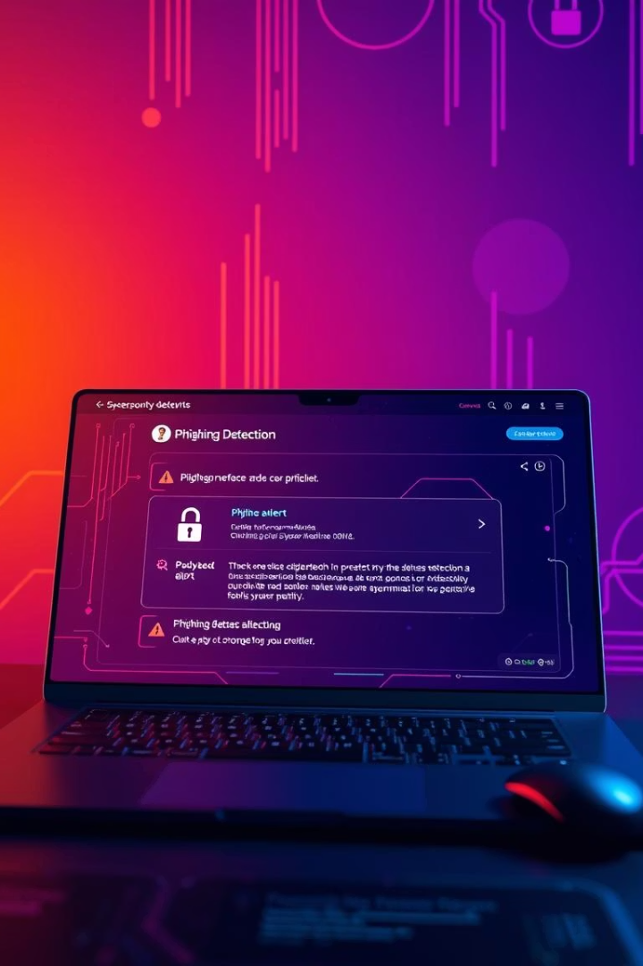
Demonstration
Watch CYBER_EYE detect phishing attempts live and in real time.

Slide 7
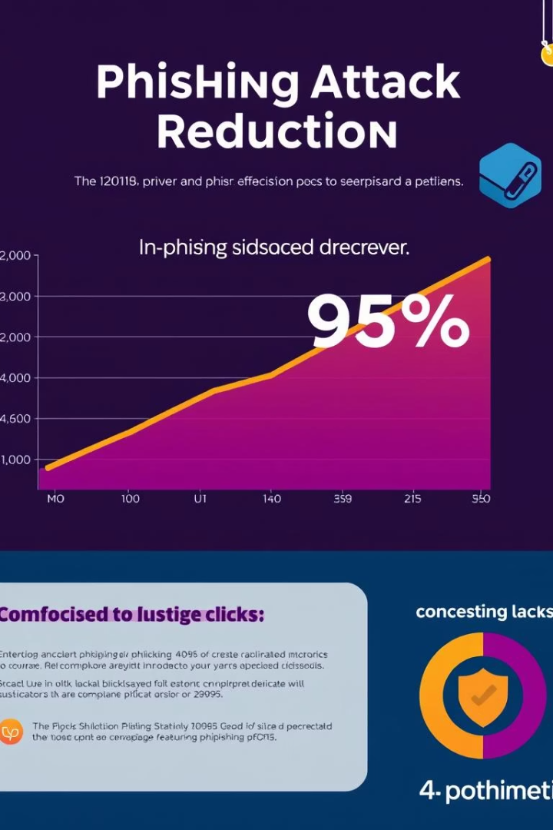
Results & Impact
95%
$2.1M
Click Rate Reduction
Losses Prevented
6M
Monitoring Period
Significant security enhancement and risk mitigation achieved.

Slide 8


Conclusion: Secure the Future with CYBER_EYE
Proactive Protection
Defends against evolving phishing schemes effectively.
Scalable Solution
Grows with your security needs and challenges.
Ready for Deployment
Seamless integration into existing security infrastructures.

Slide 9
THANK YOU

